Slide 1
SMART - SMartphone Addiction Reducing Tool
CS 565 project - Team 5
Aravind Sagar, Shirdon Gorse, Dong Hun Lee
Problem
Correlation between new media screen time and depression
Smartphone addiction generally rising; hampering productivity
No comprehensive solutions as of now
Solution
Smartphone application monitoring and guided application blocking
Daily usage limits for addictive apps - app is blocked by SMART after this
Mood recognition for visualization and restriction recommendations

Slide 2
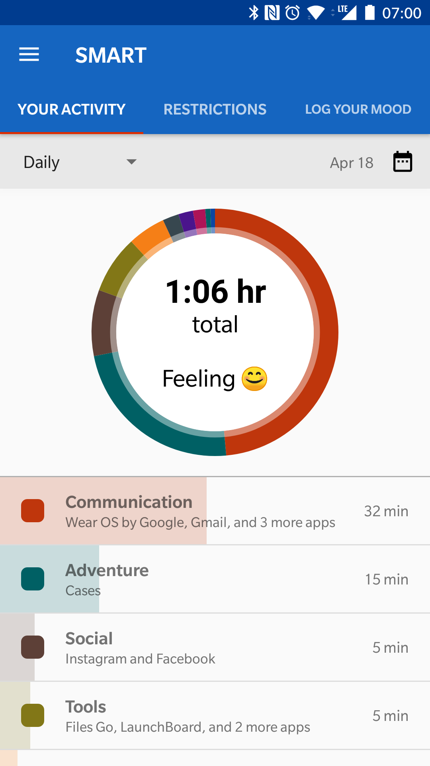
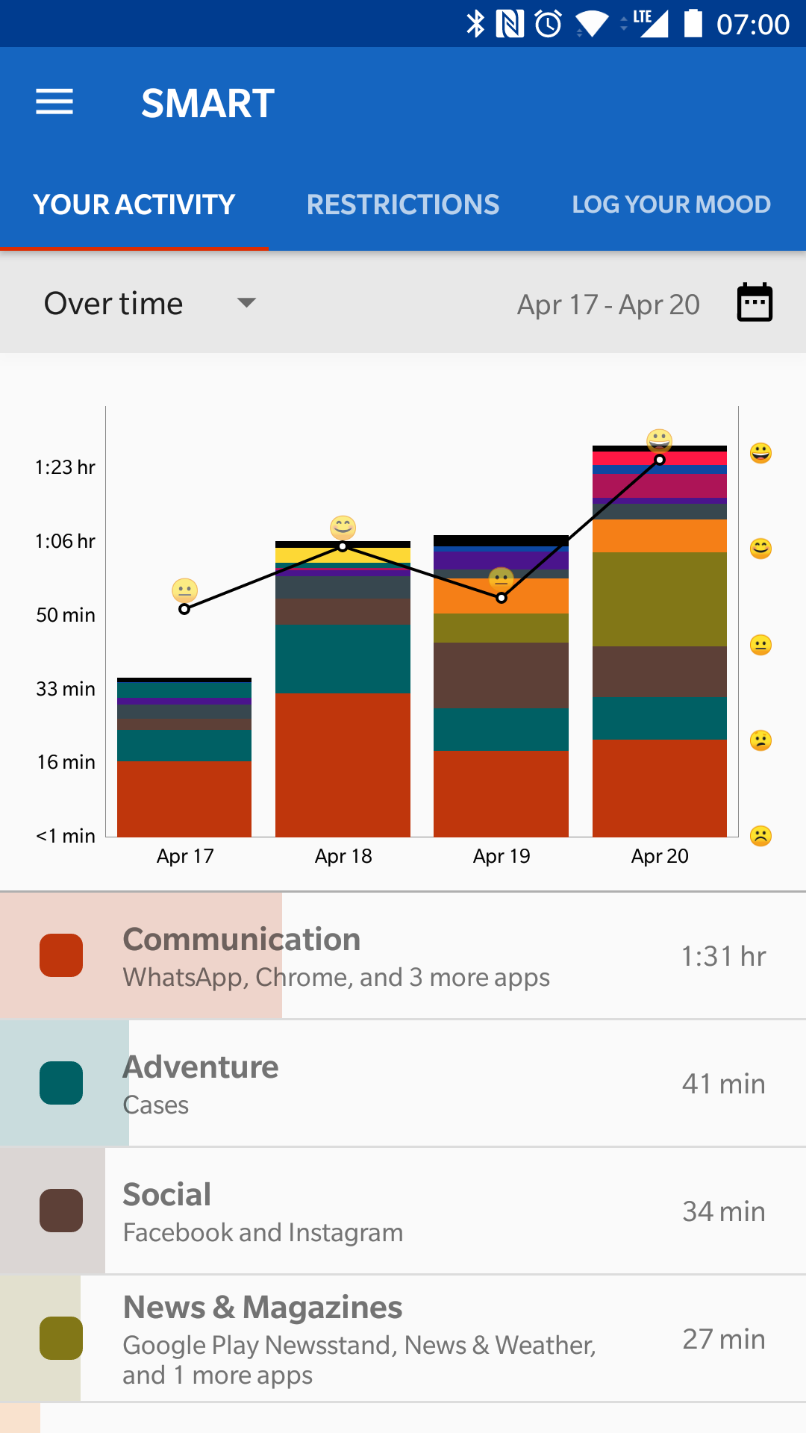
App usage data visualizations
Day view as well as aggregate reports
Grouped by category, can dive deeper for more details

Slide 3
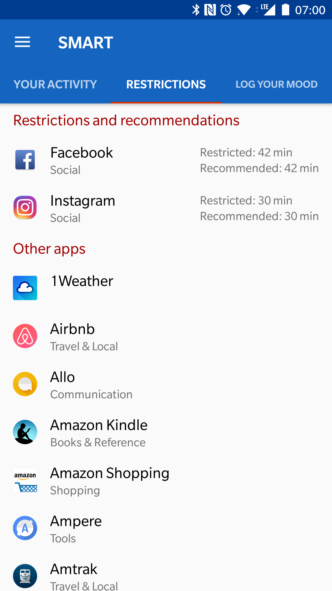
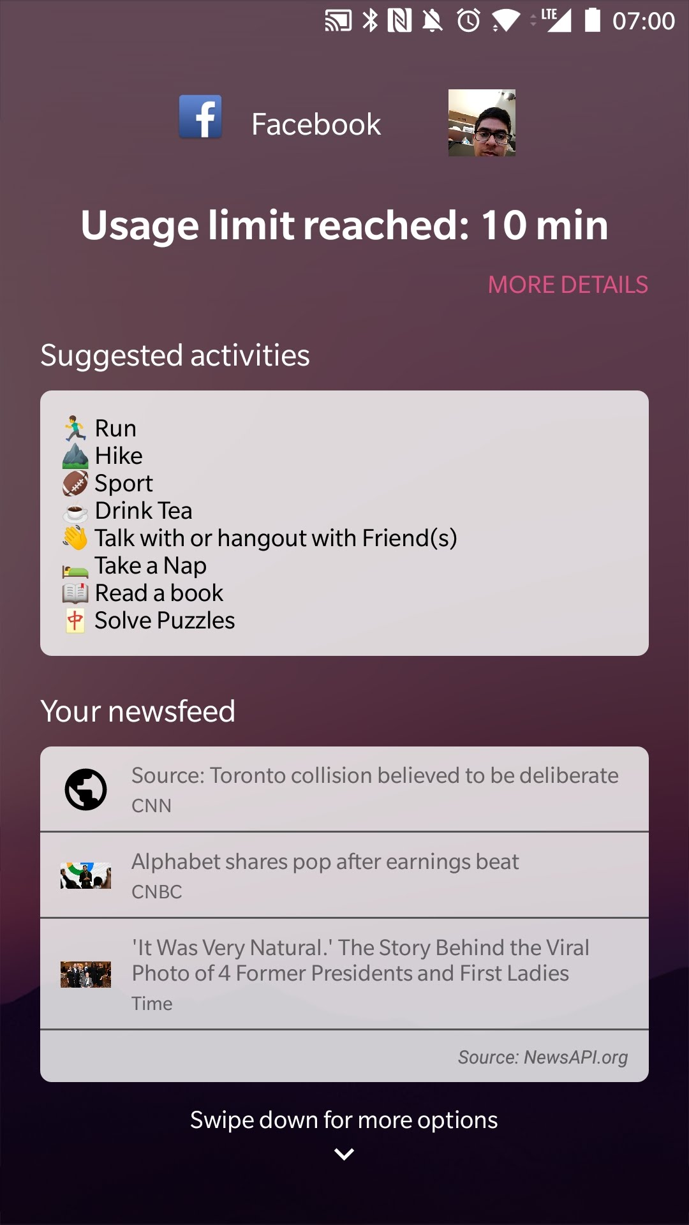
2. Per-app restrictions and blocking
SMART recommends apps to be restricted and the threshold duration
App blocked after daily usage reaches the set threshold
Provides alternate activities/newsfeed (more modules like Calendar and To-do list planned)
Blocks can be bypassed by default by swiping down and clicking a button (can be disabled in SMART settings)

Slide 4
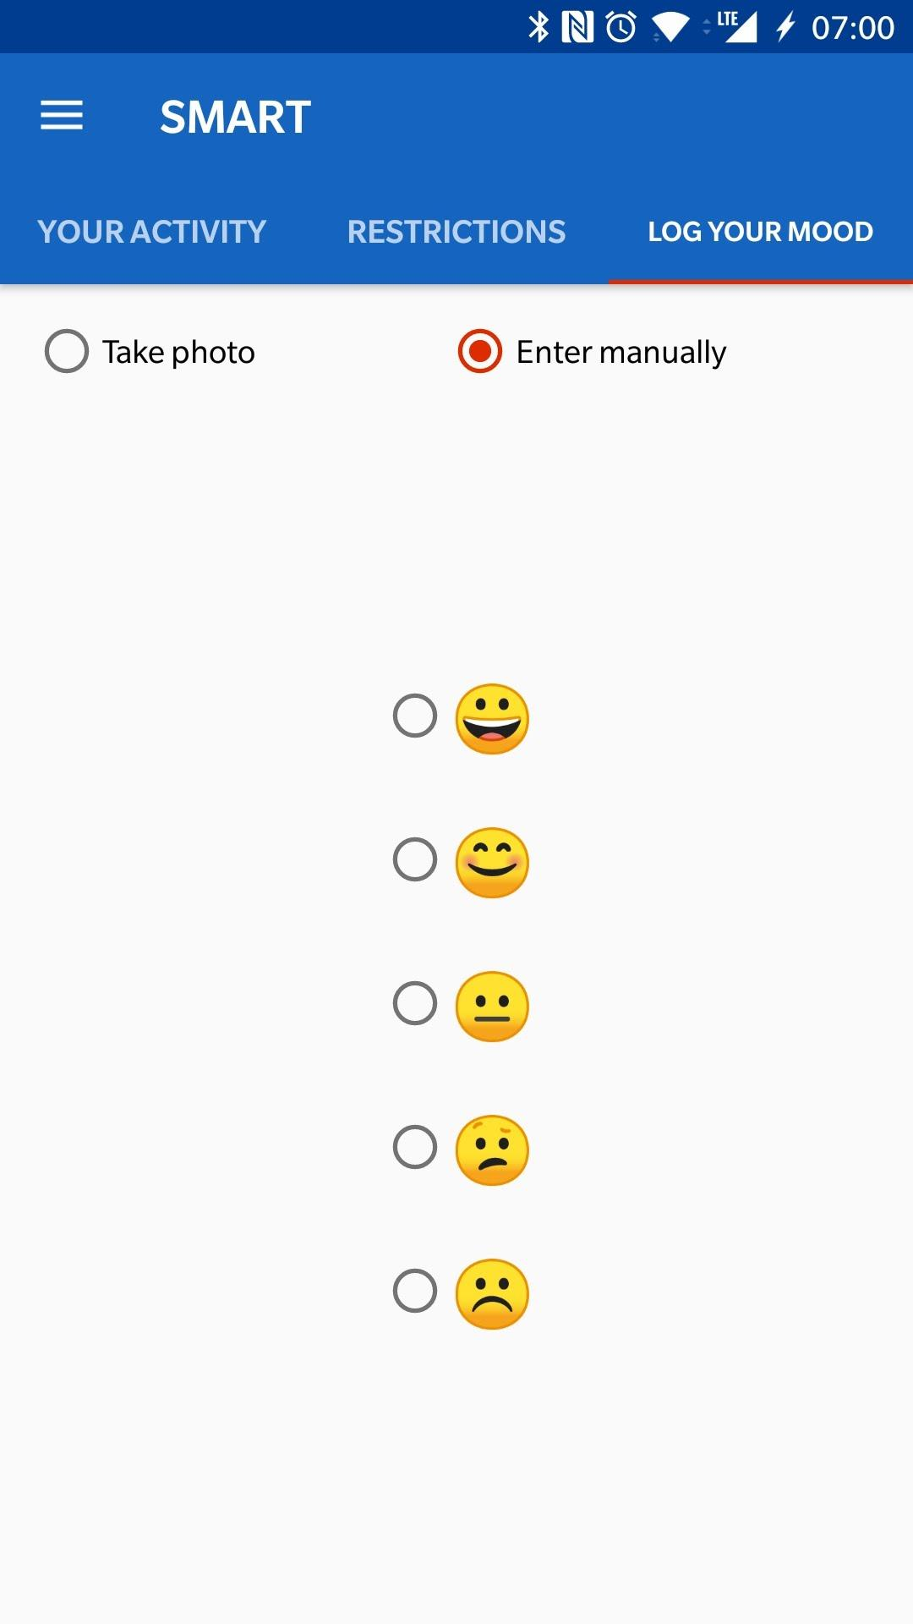
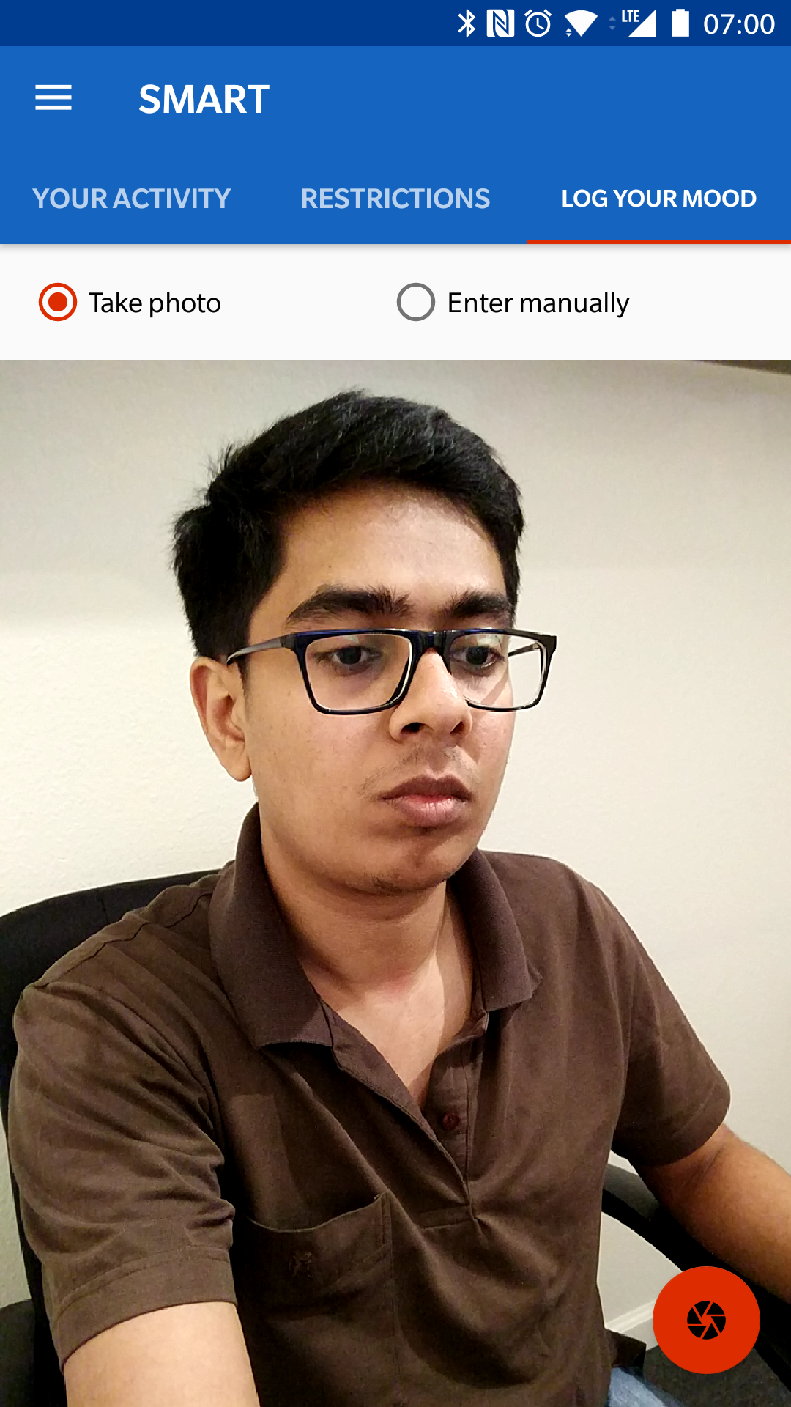
3. Mood logging
Daily mood logging
User’s self-picture
User’s manual daily mood log
Automatic picture when blocking overlay shows up
Logged mood is stored in local DB
Used to track the history of mood fluctuation in report
Used to dynamically adjust restriction threshold
Mood Recognition
Microsoft Azure Emotion API

Slide 5
Conclusion
User feedback
App usage visualizations - very helpful, motivating, surprised to see usage
Daily restrictions and blocking - very helpful, mixed opinion on bypassable blocks
Activity suggestions - offline activity suggestions are helpful, news may not be
Mood recognition - great idea if recognition is accurate
Future work
Personalized and customizable activity suggestions on app-block screen (for example, calendar entries, to-do list)
Reducing or removing restrictions will take effect only after a delay, say 24 hours.
Desktop version to complement the mobile app
Integrating Emotion API in the app.

Slide 6
https://photos.app.goo.gl/yqtGy9146g99cHZk2

